Slide 1

UNIVERSITY OF TORONTO DATA ANALYTICS BOOTCAMP
Final Project:
HOUSING PRICE PREDICTION IN TEXAS

Slide 2

EXECUTIVE SUMMARY
Overview: Housing prices in Taxes-United States persistently rise alongside increasing incomes.
Our team has chosen this topic with the goal of predicting the future changes in housing prices over
the years.
Objective: Through the analysis of housing market data spanning from 2015 to 2023, our Housing
Price Prediction Tool aims to forecast whether the housing market in Taxes will
experience an upward or downward trend in the next year.

Slide 3





Presentation Sections:
Data Exploration & Cleaning
Database
Machine Learning
Dashboard

Slide 4

TEAM MEMBER & ROLES
Bilal Ismail
Cleaning Data
Gurpal Gill
Data Base
Clarajean Lugenge
Tableau
Carson Moore
Presentation
Stephen Fernandes
Machine learning

Slide 5





TECHNOLOGY WE USED

Slide 6

SOURCING THE DATA
Our team sourced data from verified sites to answer our confirmed analysis questions. We pulled multiple data sets with information on housing prices, Income, population, etc. that will support our overall analysis. We will answer the following questions with our data:
Given the data available, can we expect housing prices to increase or decrease in the coming years?
For a given Zip code, which other zip codes have similar housing and demographic data?
For a given Zip codes, what pertinent information should be understood by someone looking to move to the area?

Slide 7

DATA EXPLORATION _ ETL
Extract:
Extract clean data from multiple confirmed sources, ensuring it has all necessary information and limited null values
2. Transform:
Transform data, removing null values and unnecessary columns, joining datasets, creating separate data frames, and creating look-up tables
3. Load:
Load the data by writing it into Postgres using the confirmed look-up tables to allow multiple users to access

Slide 8

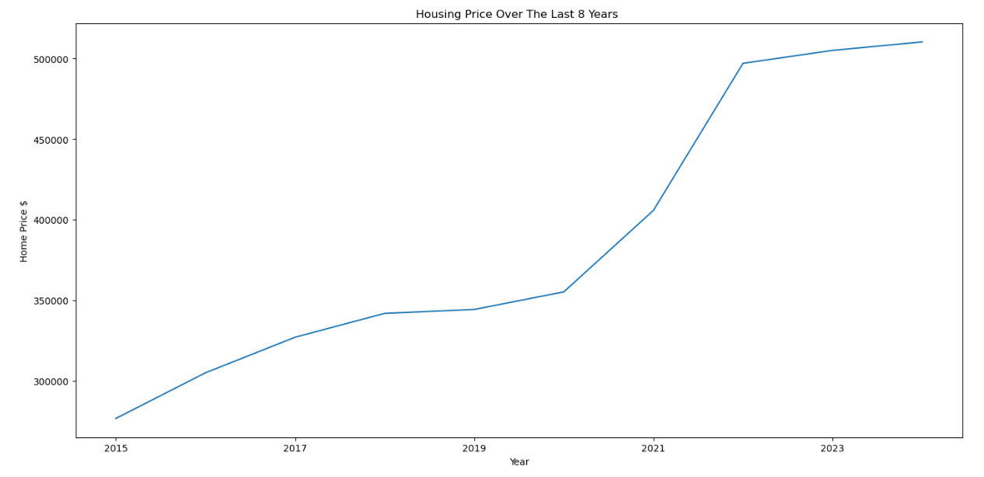
PRELIMINARY ANALYSIS
Looking at two zip code, 75001.0 and 75010.0, we found that housing prices have increased over the years
Preliminary Conclusion: Given the data for these two Zip code, it is possible housing markets may keep increasing within the next few years.

Slide 9

DATA AND SOURCES
Kaggle/Zillow - Zillow US House Price Data
Census - US City and Town Population Totals: 2015-2023
Kaggle/MoveHub - MoveHub City Rankings

Slide 10

DATABASE

Slide 11

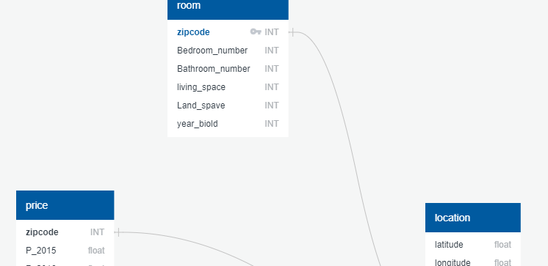


DATABASE PROCESS
Used Postgres by way of PgAdmin as our database to house the tables of data
AWS Relation Database Service for access by multiple users

Slide 12

MACHINE LEARNING

Slide 13


PRELIMINARY DATA PREPROCESSING
'zipcode', 'latitude', 'longitude', 'state', 'population', 'bedroom_number', 'bathroom_number', 'living_space', 'land_space', 'year_built', '2015', '2016', '2017', '2018', '2019', '2020', '2021', '2022', '2023', 'net_income', '2024'
Check data types for all columns in all housing prices dataset
Data set included zip code, population, average bedroom number, average bathroom numbers, average living space, average land space, average year build, prices with the steps of month from 2015 to 2023.

Slide 14

PRELIMINARY FEATURE ENGINEERING & SELECTION
We have identified several features that could potentially be relevant for a machine learning prediction task related to real estate or property-related analysis. Each of these features provides different types of information that can be useful for making predictions or gaining insights.

Slide 15

Features
5.Average Bathroom Number:
Similar to bedrooms, the number of bathrooms is a significant factor in property valuation and attractiveness.
6.Average Living Space:
Living space is a critical feature, as it directly relates to the size of the property and can influence its value.
7.Average Land Space:
The size of the land associated with a property can impact its overall value, especially in terms of outdoor space and potential for development.
8.Average Year Built:
The age of a property can be a relevant factor, as newer properties might have different features or be in better condition than older ones.
9.Average Prices from 2015 to 2023:
Historical price data provides a time series aspect, allowing your model to understand trends and patterns in property prices over the years.
Zip Code for Taxes:
This feature could be important for understanding the geographical location of properties and might have implications for tax rates.
Population for Each Zip Code:
Population data can give you insights into the density of an area, which might be relevant for predicting property demand or value.
Average Income:
Average income is a key socioeconomic factor that can influence the affordability of properties in a given area.
Average Bedroom Number:
The number of bedrooms in a property is a fundamental characteristic that often correlates with property size and family needs.

Slide 16

MODEL
We've listed a variety of machine learning models for our prediction task. Each of these models has its own strengths and weaknesses, and their suitability depends on the nature of our data and the specific goals of your prediction:
Basic Linear Regression
Logistic Regression
Random Forest Optimized
Random Forest Train
Neural Network

Slide 17

MODEL CHOICE

Slide 18
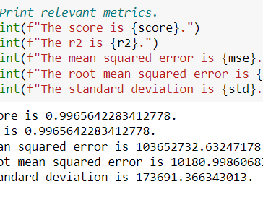

LINEAR REGRESSION
We decided to work with a linear regression model due to its achieved accuracy of 90%.

Slide 19

CONCLUSION FOR LINEAR REGRESSION
The model's performance metrics indicate an exceptionally high level of accuracy and precision. With an R2 score and a correlation coefficient both equal to 0.9966, the model demonstrates a strong ability to explain the variance in the data. The mean squared error of 103652732.63 and the root mean squared error of 10180.9986 suggest that the model's predictions are very close to the actual values, with minimal deviation. Additionally, the standard deviation of 173691.3663 highlights the consistency of the model's predictions. Overall, these metrics collectively affirm the reliability and effectiveness of the model in capturing the underlying patterns within the data.

Slide 20

DASHBOARD

Slide 21

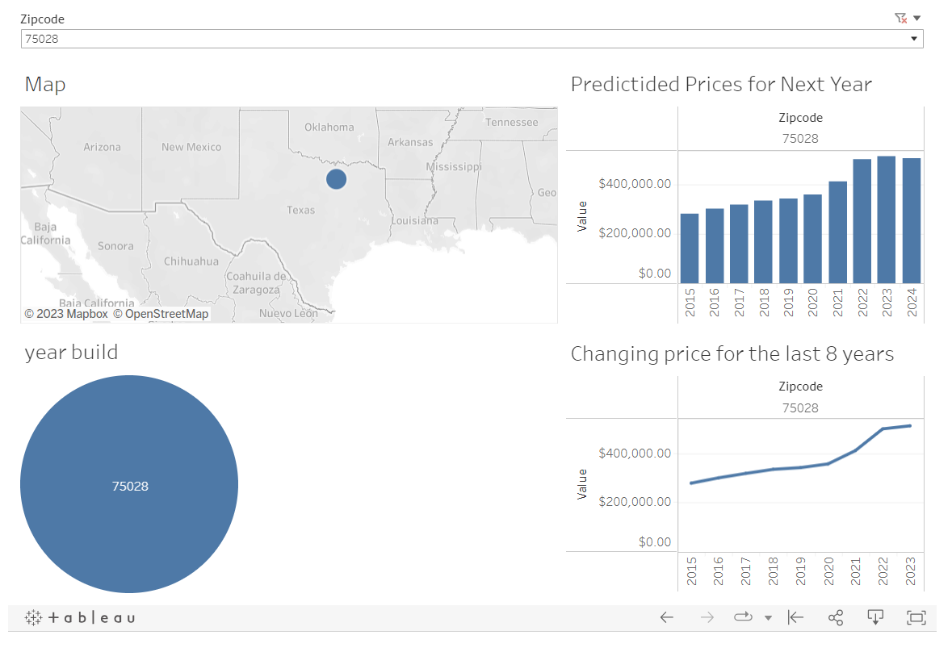
DASHBOARD DESIGN

Slide 22
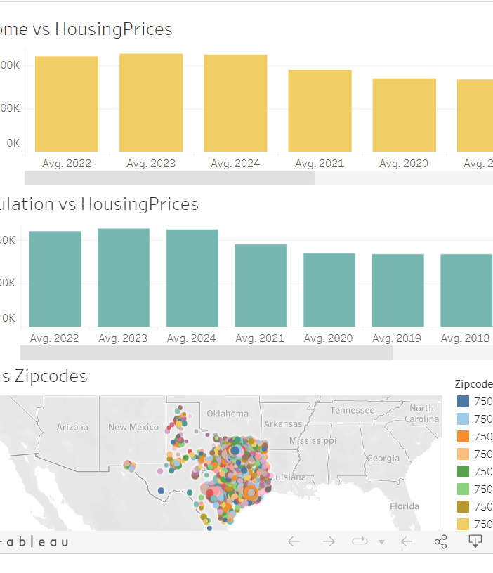
DASHBOARD DESIGN

Slide 23

DASHBOARD ELEMENTS
Interactive elements:
The Zip code will be selected from a drop-down menu.
Shows the relation between income, population and housing price.
Other elements:
The remaining elements in the dashboard are static but are designed to effectively showcase various skills we have learned throughout the course.
The graphs reflect information from our dataset and allow the user to get a good overview about the zip code they are looking at. This information is helpful for anyone looking to move to Taxes.

Slide 24
INTERACTIVE DASHBOARD
For the dashboard segment of this project, we will be using Tableau Public. Click here to view our interactive dashboard embed, and here to view our second interactive dashboard

Slide 25

CONCLUSION

Slide 26

Analysis Results
Based on historical data, we can identify that the leading indicators that reliably predict changes in housing prices to be the average income and the average population quantity of a city in the state of Texas. Analyzing the data and using linear regression models and plotting well informed graphs, we can identity a positive correlation between the average income in Texas to the average housing prices and the average population in each city to the average housing pricing in Texas, in that as the income or population quantity increases/decreases, the housing prices also increase/decreases. Furthermore, it can be concluded that the housing market is stable seeing that the historical trend doesnt involve any major highs and lows in the market (This is based on historical data found which only relates to income and population in relation to housing prices and does not accurately represent all the factors that may influence in the housing market).

Slide 27

Recommendation for Future Analysis
Explore more data sources to find more factors that could influence housing prices
Compare models against each other with their RMSE with naive forecasting
Use more features for machine learning such as Transpirations status, weather, education level, basement status, back yard status, neighborhood safety, market status, ect

Slide 28

Finally
Certainly! It's great to hear that all members of group 3 appreciate the attention and are open to questions. Your positive feedback is appreciated! If there's anything specific, you'd like assistance with or if you have any questions, feel free to let us know. We are here to help!

Slide 29

The end

